Slide 1
Attracting Inventors to TechReady Blocks using Patent Dataset Analysis and Insights
Presented By
BIBEK LAMSAL

Slide 2
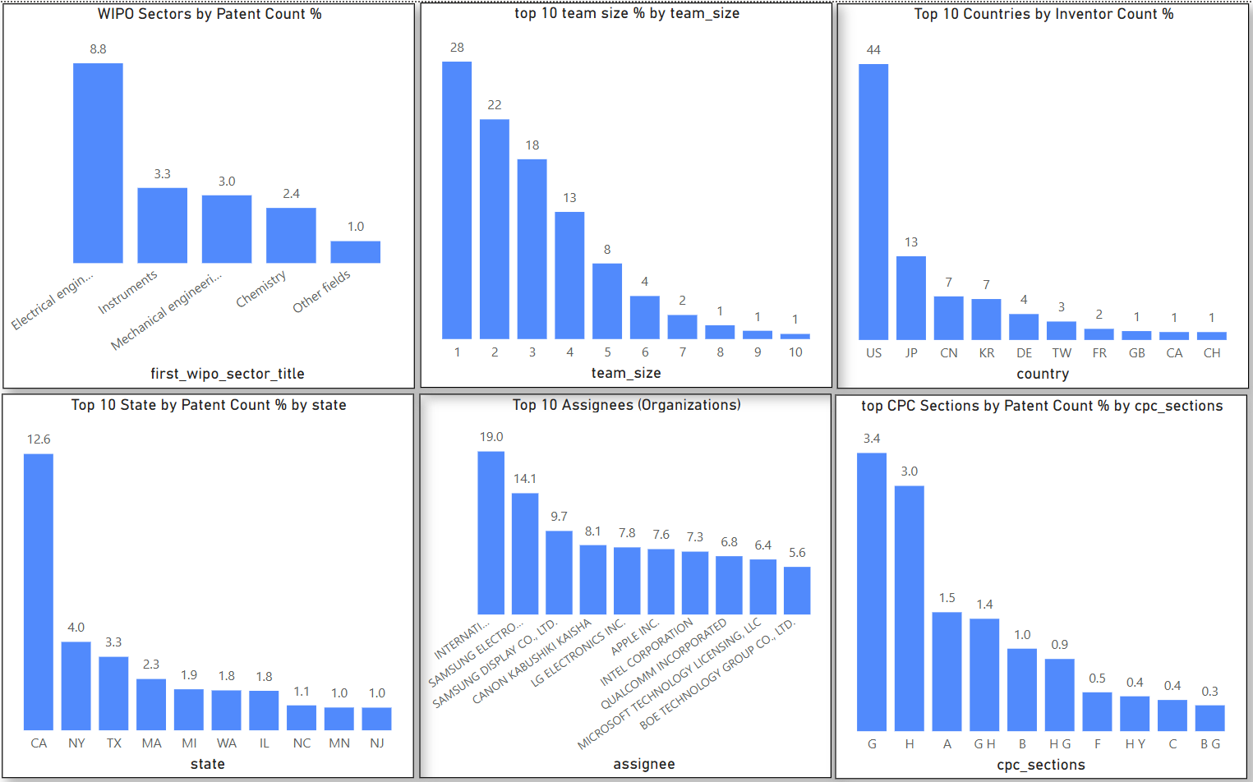
Visualization using dashboard

Slide 3
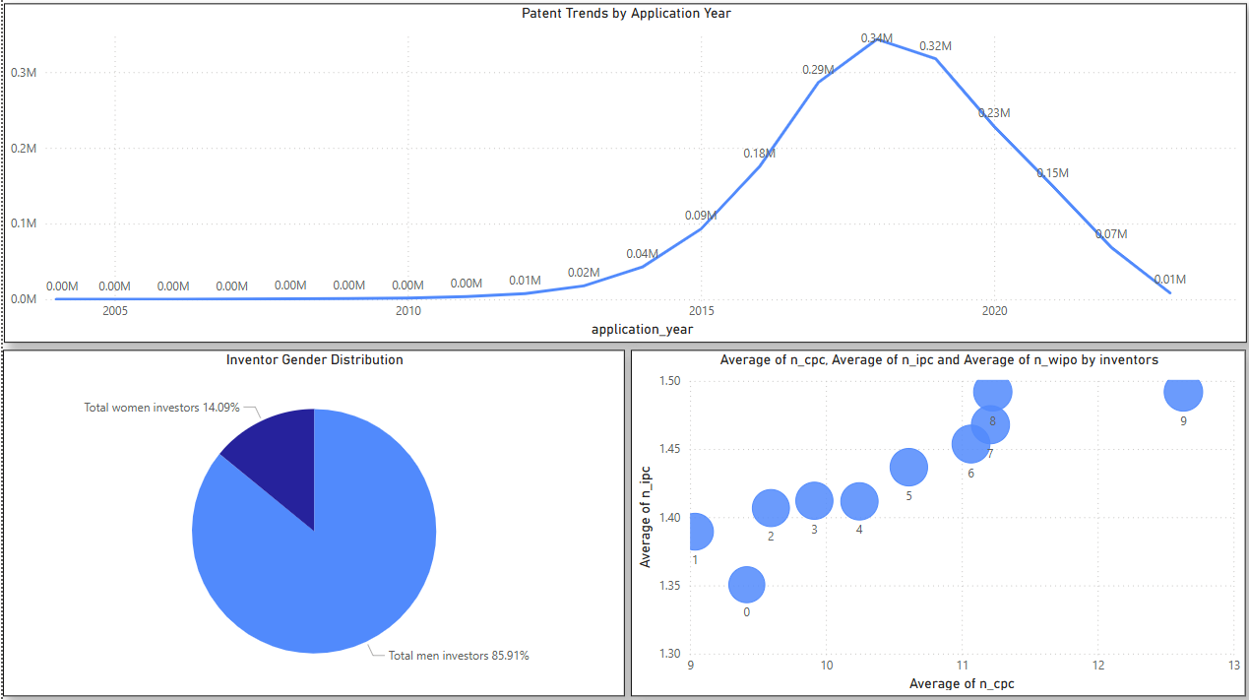

Slide 4
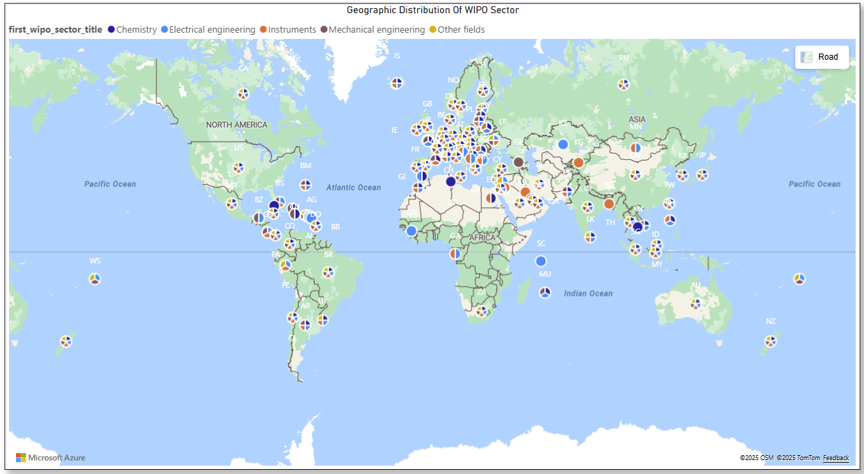

Slide 5
Insight:
Focus on Electrical Engineering Sector: The WIPO sector chart shows Electrical Engineering dominates patent filings (8.8%) , followed by “Instruments”(3.3%) and Mechanical Engineering(3.0%).
Inventor Teams of 1–3 Are Most Productive: Over 70% of patents come from teams with 1–3 inventors.
US Dominates Patent Contributions: The US accounts for 44% of inventors, followed by Japan(13%) , China(7%) , Korea(7%) , and Germany(4%).
Women Are Underrepresented: Only 14.09% of inventors are women.
Patent Activity Peaked Around 2018–2019: Patent filings peaked before COVID, then dropped sharply.

Slide 6

RecommEndation
1. Focus on U.S.-Based Inventors and Organizations:
California (CA) alone leads among states by patent count %, suggesting a strong innovation hub. Major assignees like Apple, Intel, and Microsoft are also U.S.-based. TechReady should build partnerships or run campaigns targeting inventors and research teams in key U.S. states, especially California, New York, and Texas.
2. Target Engineering-Focused Innovators (Especially Electrical and Mechanical):
CPC sections G (Physics) and H (Electricity) are the top technical areas. TechReady should tailor programs, funding, and recognition initiatives toward engineering-heavy patent fields. These areas show the highest concentration of innovation and inventors.
3. Promote and Support Women Inventors:
TechReady should launch women-in-invention programs, including grants, mentorship, and training, especially in fields like chemistry and instruments where female representation might be higher.

Slide 7
Call To Action
Let’s set a meeting with the Tech-Ready Marketing Team to collaborate with innovation hotspots like California and other global hubs to uncover current market needs and design campaign to attract future-ready inventors.

